Slide 1
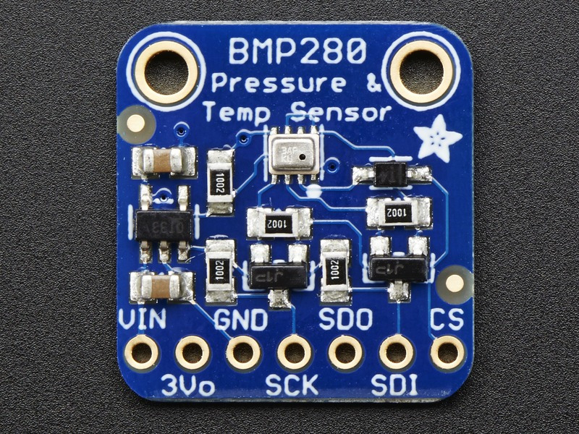
BMP280(Barometric Pressure & Altitude Sensor)

Slide 2
Proposal
The purpose of my sensor(BMP280) is to get the readings of Pressure, Temperature and Altitude. And I have attached a display(1.8 TFT ST7735) for presenting the readings on it.

Slide 3
Budget
Item | Supplier | Price
1.8 TFT ST7735 | Adafruit | $27.54
BMP280 | Amazon | $22.60
STM32F103C8T6(Blue pill) | Amazon | $6.22
FTDI USB to TTL Serial converter | Amazon | $9.65
Total |  | $66.01

Slide 4
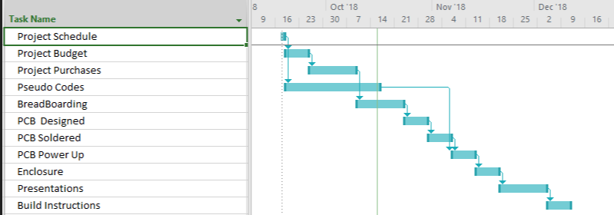
Schedule

Slide 5
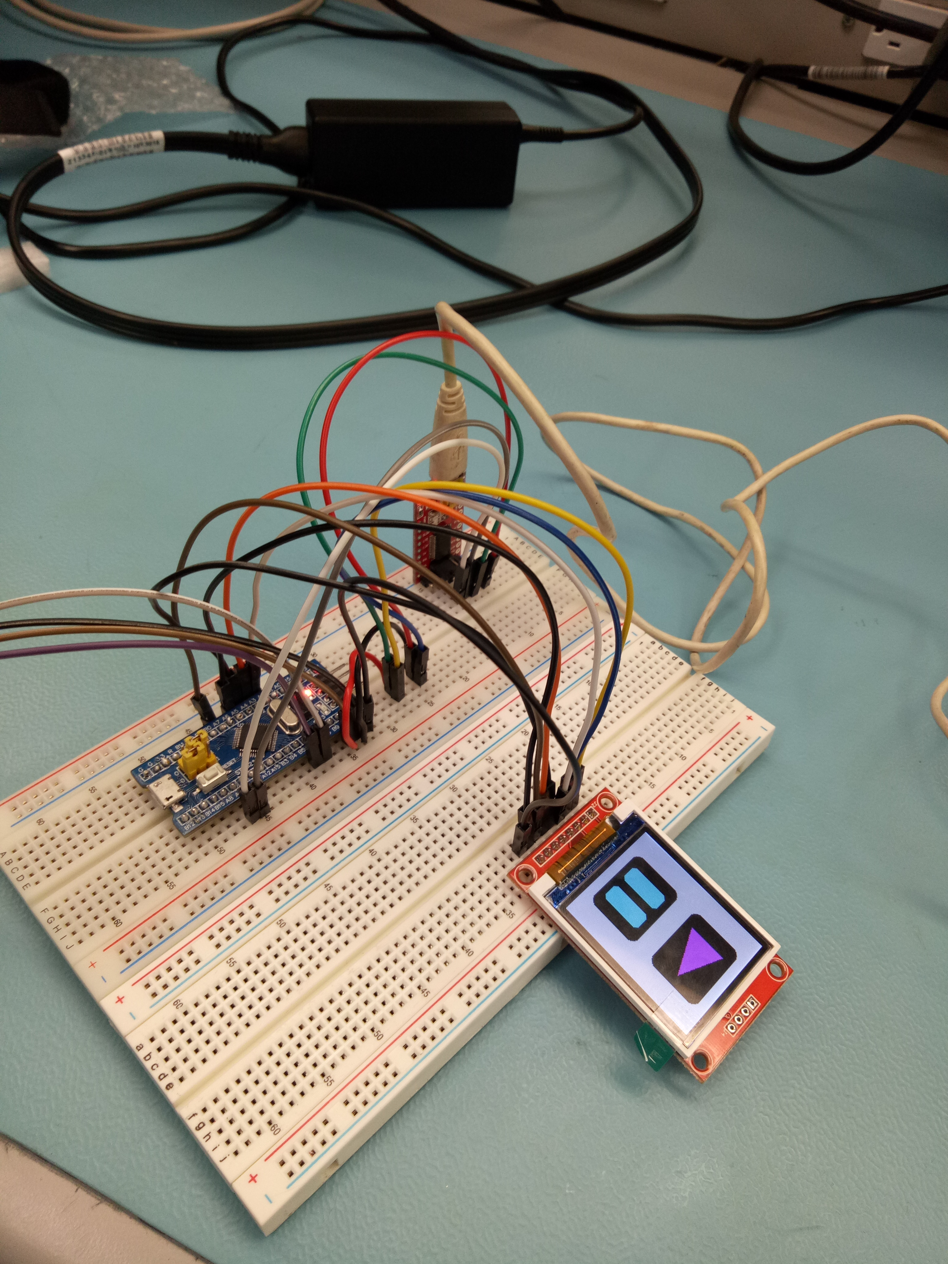
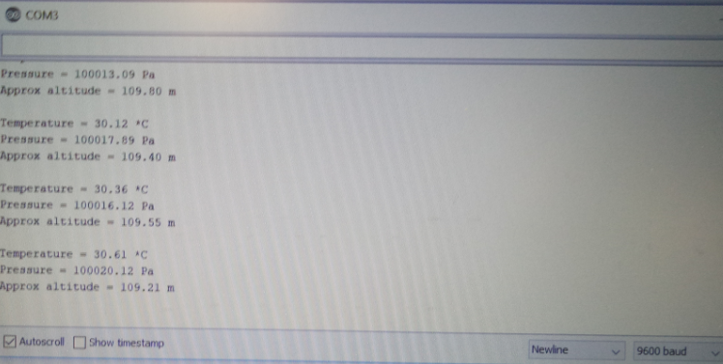
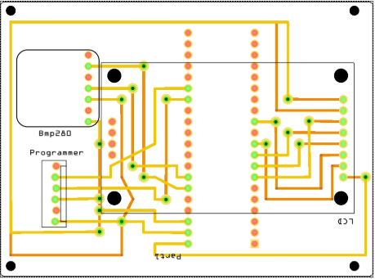
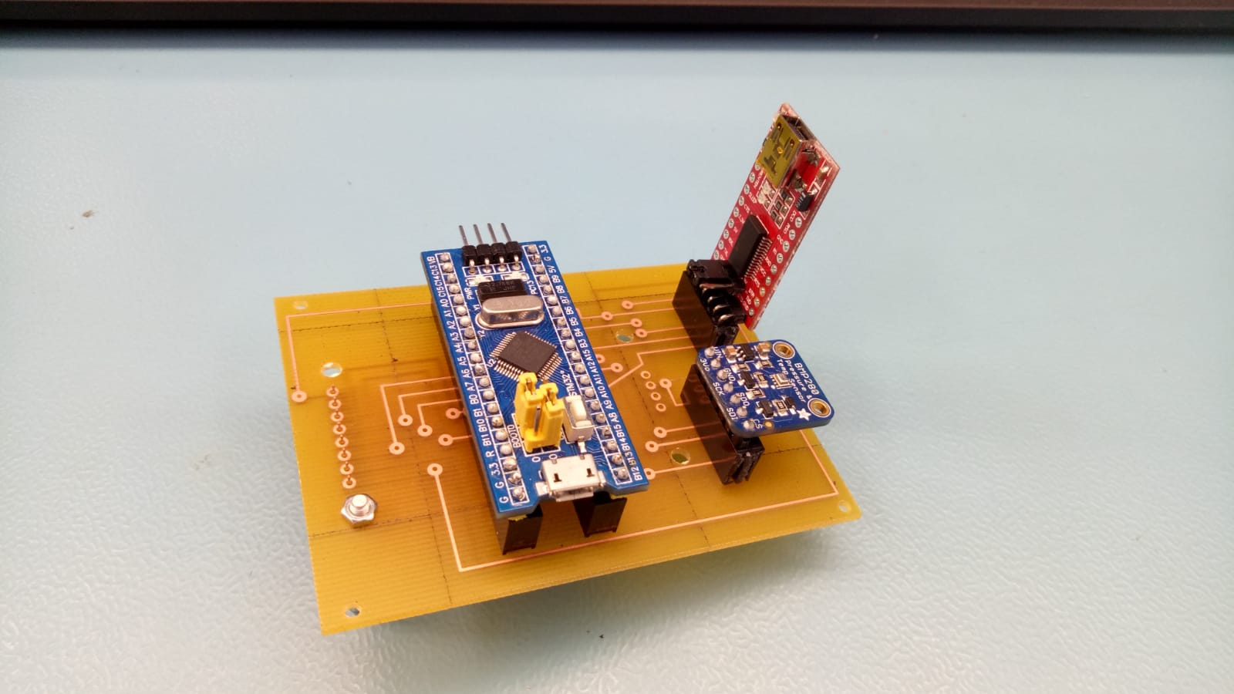
Overview
Circuit
Readings
PCB Designing
Soldered

Slide 6
Course Schedule
CENG 209 : Micro Assembly Language Programing
CENG 215 : Digital And Interfacing Systems
CENG 220 : Technical workplace Writing Skills
CENG 252 Embedded Systems

Slide 7
Thank you

